Slide 1
The long-term impact of the COVID-19 pandemic on the mental health and wellbeing of adults in the UK
Eleonora Iob
Psychobiology Research Group
Institute of Epidemiology and Health Care
University College London
ACAP Webinar Series, University College Dublin
Friday 25th June 2021
Email: Eleonora.iob.17@ucl.ac.uk
Twitter: @Eleonora_Iob

Slide 2
Outline
The initial mental health impact of the COVID-19 pandemic
    Findings from the UK COVID-19 Social Study
The longer-term mental health impact of the COVID-19 pandemic
    Findings from the UK COVID-19 Social Study and
    the ELSA COVID-19 Substudy
Implications and future research priorities

Slide 3
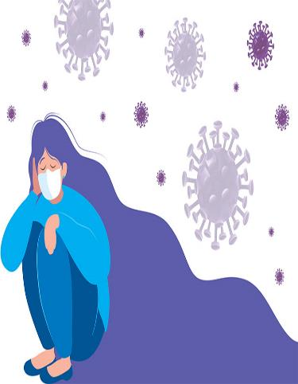
The initial mental health impact of the COVID-19 pandemic
Burden of mental disorders before COVID-19
Prevalence of common mental health disorders:
  17.6% globally (Steel et al., 2014)
  17.7% in the United Kingdom (UK) (OECD/EU, 2018)
  18.5 % in Ireland (OECD/EU, 2018)
Proportion of years lived with disability (YLD) due to mental disorders
(WHO, 2019):
  20.6% globally
  23.8% in the UK
  25.4% in Ireland
Economic impact (OECD/EU, 2018):
  € 8.3 billion in Ireland, i.e. 3.17% of GDP
  € 106 billion in the UK, i.e. 4.07% of GDP

Slide 4
The initial mental health impact of the COVID-19 pandemic
Psychosocial effects of the COVID-19 pandemic
(Brooks et al., 2020; Holmes et al., 2020)
COVID-19-related stressors:
Economic adversity (e.g. loss of employment, financial instability, poverty) (World Bank, 2020; ONS, 2021)
Social isolation, loneliness, and physical inactivity (Ammar et al., 2020; Hwang et al., 2020; Meyer et al., 2020; Puccinelli et al., 2021)
Illness or death of relatives/friends and fear of the virus
Reduced access to health and social care services (Campion et al., 2020)
Short-term and long-term psychological consequences of COVID-19 infection (Luo et al., 2020)

Slide 5
The initial mental health impact of the COVID-19 pandemic
Mental health during the early months of the pandemic
Meta-analysis (N=41): High levels of depression (28%) and anxiety (33%) in the adult population worldwide (Luo et al., 2020)
  Pre-pandemic global prevalence: 4.4% for depression and 3.6% for anxiety (WHO, 2017)
UK longitudinal cohort study: proportion with clinical significant levels of mental distress increased from 19% in 2018/19 to 27% in April 2020 (Pierce et al., 2020)
Meta-analysis (N=65): significant increases in symptoms of depression [standardised mean change (SMC) = .216] and anxiety (SMC = .125) compared with pre-pandemic levels worldwide (Robinson et al., 2021)

Slide 6
The initial mental health impact of the COVID-19 pandemic
Mental health during the early months of the pandemic
Social distancing measures and COVID-19-related stressors might have contributed to higher levels of domestic abuse and violence (Usher et al., 2020)
UK:
In mid-May 2020, there was a 12% increase in the number of domestic abuse cases referred to victim support (ONS, 2020)
In April-June 2020, there was a 65% increase in calls to the National Domestic Abuse Helpline, compared to Jan-Mar 2020
(House of Commons, 2021)
It is necessary to identify individuals at risk of experiencing abuse and psychological distress during COVID-19 to inform the targeting of interventions

Slide 7
The initial mental health impact of the COVID-19 pandemic
Study 1: “Abuse, self-harm, and suicidal ideation in the UK during the COVID-19 pandemic”
Iob, Steptoe, & Fancourt (2020), British Journal of Psychiatry
Objectives
To explore patterns of abuse, self-harm, and suicidal ideation in the first month of lockdown (March-April 2020)
To identify levels of engagement with formal and informal mental health support
Sample
44,775 adults aged 18 years and older participating in the UK COVID-19 Social Study

Slide 8

The initial mental health impact of the COVID-19 pandemic
The UK COVID-19 Social Study
Panel study of over 70,000 respondents focusing on the psychosocial
experiences of adults living in the UK during the COVID-19 pandemic
Data collected through weekly online surveys across over 60 weeks
Topics: diagnosis/experience of COVID-19, COVID-19 attitudes, mental health, adverse experiences, social and health behaviours, time use
The study is not representative of the UK population, but it has good representation across all major socio-demographic groups
All data are weighted to the proportions of gender, age, ethnicity, education,
and country of living obtained from the Office for National Statistics

Slide 9
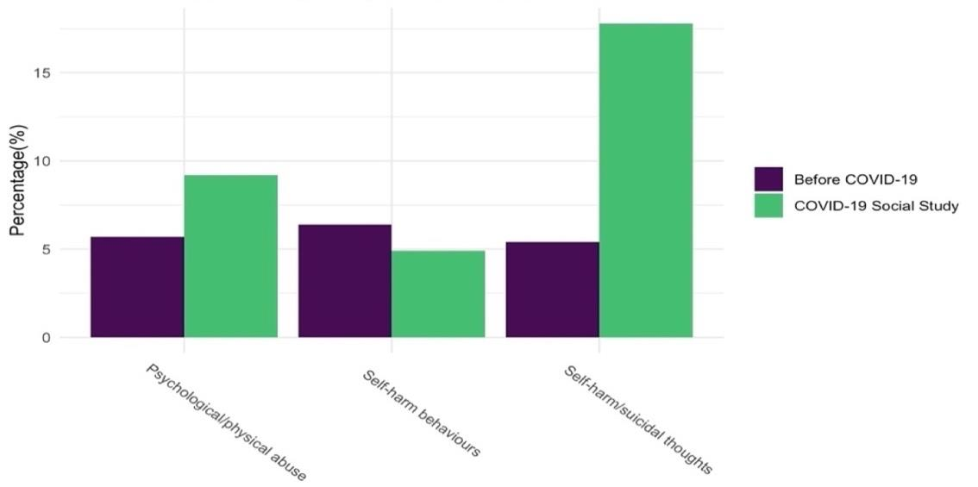
The initial mental health impact of the COVID-19 pandemic
17.8%
9.2%
5.7%
6.4%
5.4%
4.9%
Prevalence of abuse, self-harm, and suicidal ideation in the COVID-19 Social Study (March-April 2020) versus pre-pandemic prevalence studies

Slide 10
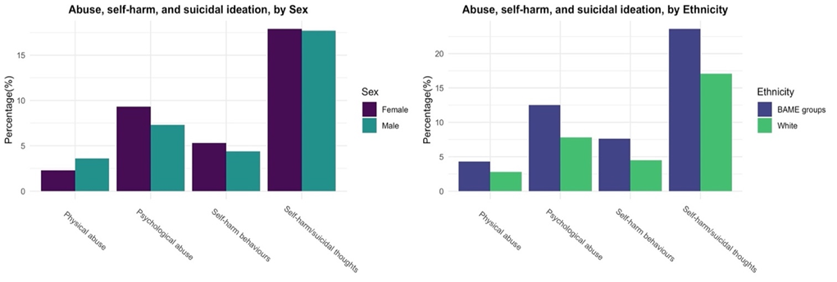
The initial mental health impact of the COVID-19 pandemic
Prevalence of abuse, self-harm, and suicidal ideation in the COVID-19 Social Study by sex and ethnicity (March-April 2020). Note: BAME = Black, Asian, and Minority Ethnic (BAME) groups

Slide 11
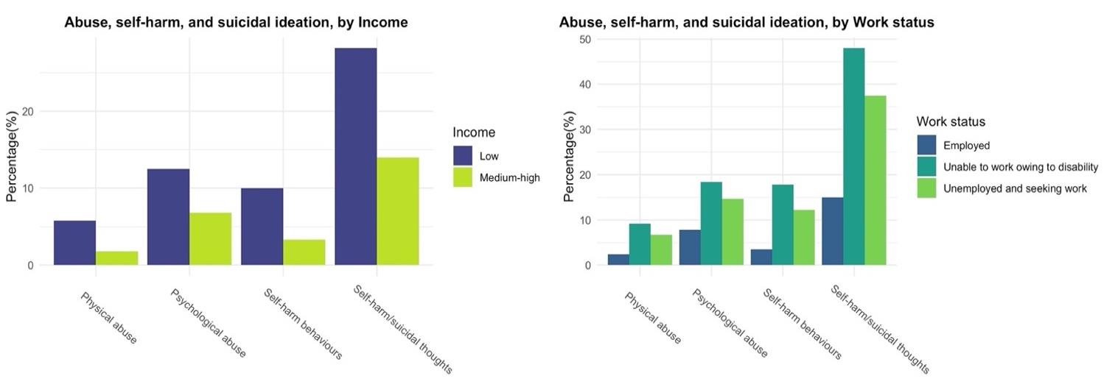
The initial mental health impact of the COVID-19 pandemic
Prevalence of abuse, self-harm, and suicidal ideation in the COVID-19 Social Study by income and work status (March-April 2020)

Slide 12
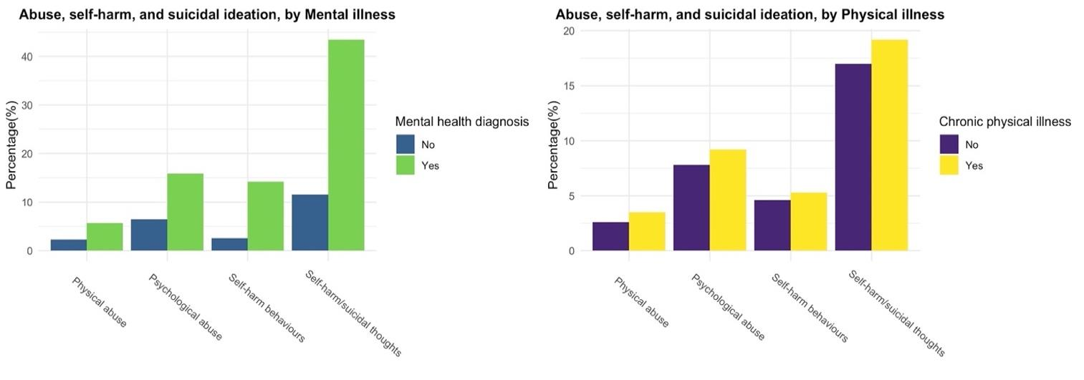
The initial mental health impact of the COVID-19 pandemic
Prevalence of abuse, self-harm, and suicidal ideation in the COVID-19 Social Study by pre-existing physical and mental illness (March-April 2020)

Slide 13
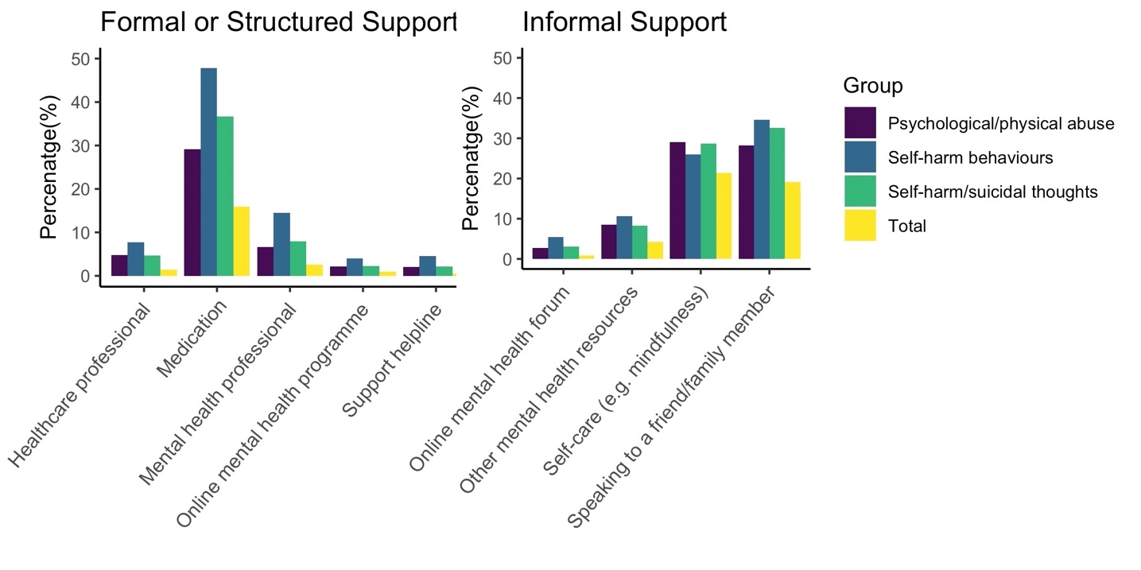
The initial mental health impact of the COVID-19 pandemic
Formal/structured and informal mental health support in participants with experiences of abuse, self-harm behaviours, and suicidal ideation

Slide 14
The initial mental health impact of the COVID-19 pandemic
Mental health support in the COVID-19 Social Study vs pre-pandemic prevalence studies
 | Pre-pandemic prevalence studies | UK COVID-19 Social Study
Speaking with a mental health professional (self-harm) | 20% (McManus et al., 2019) | 14.5%
Speaking with a mental health professional (﻿thoughts of self-harm or suicide) | 25.5% (McManus et al., 2016) | 4.7%
﻿Speaking with friends or family members (﻿thoughts of self-harm or suicide) | 21.7% (McManus et al., 2016) | 32.6%

Slide 15
The initial mental health impact of the COVID-19 pandemic
Study 2: “Levels of Severity of Depressive Symptoms Among At-Risk Groups in the UK During the COVID-19 Pandemic”
Iob, Frank, Steptoe, & Fancourt (2020), JAMA Network Open
Objectives
To examine levels of severity of depressive symptoms during the early months of the pandemic in the UK (March-May 2020)
To identify population subgroups at greater risk of experiencing psychological distress
Sample
51,417 adults aged 18 years and older participating in the UK COVID-19 Social Study
Measures
Outcome: depressive symptoms (9-item Patient Health Questionnaire; PHQ-9)
Sociodemographic, psychosocial, and health-related vulnerabilities

Slide 16
The initial mental health impact of the COVID-19 pandemic
Group-based trajectories of depressive symptoms (March-May 2020): Low Depression (Class 1; 60%); Moderate Depression (Class 2; 29%); Severe Depression (Class 3; 11%).
Note: ﻿ PHQ-9 = 9-item Patient Health Questionnaire

Slide 17
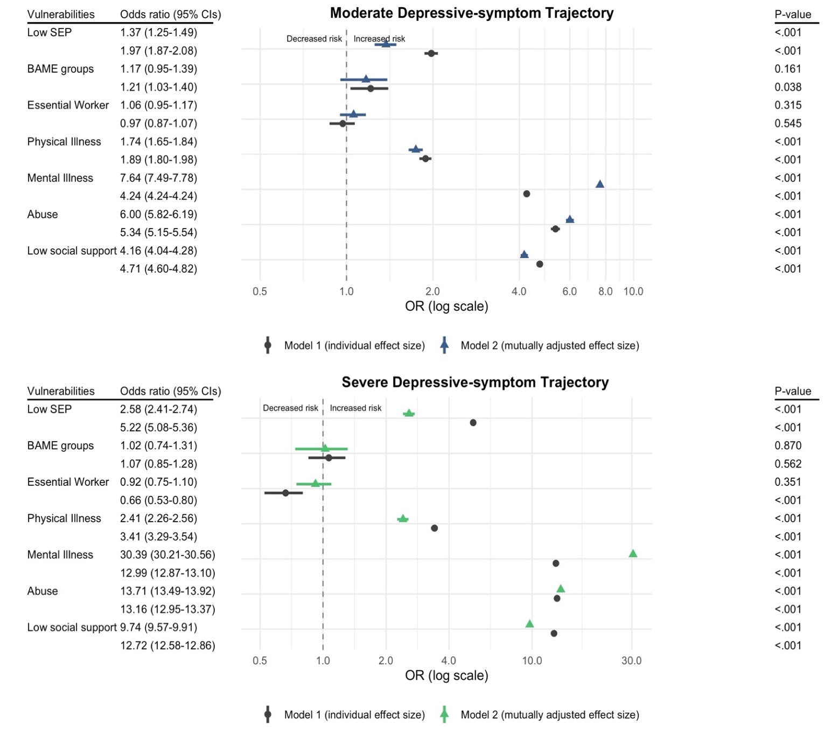
The initial mental health impact of the COVID-19 pandemic
Associations of sociodemographic, psychosocial, and health-related vulnerabilities with the risk of severe depression trajectories (vs Low).

Slide 18
The initial mental health impact of the COVID-19 pandemic
Associations of socioeconomic, psychosocial, and health-related vulnerabilities with depression in the COVID-19 Social Study vs pre-pandemic meta-analyses
Pre-pandemic meta-analyses | UK COVID-19 Social Study
Intimate partner violence: odds ratio (OR) depression = 1.87 (Beydoun et al., 2012) | Psychological/physical abuse: OR depression = 13.71
High social support: OR depression = 0.74 (Gariépy et al., 2016) | Low social support: OR depression = 9.74
Physical illness (e.g. cardiovascular disease): OR depression = 1.75 (Correll et al., 2017) | Pre-existing physical illness: OR depression = 2.41
Low SEP: OR depression = 1.81 (Lorant, 2003) | Low SEP: OR depression = 2.58

Slide 19
The initial mental health impact of the COVID-19 pandemic
Limitations of Studies 1 and 2
Although well-stratified across sociodemographic characteristics and weighted to population proportions, the COVID-19 Social Study’s sample is not not nationally representative
Lack of data before the beginning of the pandemic
However, results from the COVID-19 Social Study have been corroborated by longitudinal and nationally representative studies (Daly et al., 2020; Pierce et al., 2020)
Evidence gap
Limited data regarding the longer-term mental health impact of the pandemic

Slide 20
(ii) The longer-term mental health impact of the COVID-19 pandemic
Study 3: “The immediate and longer-term impact of the COVID-19 pandemic on the mental health and wellbeing of older adults in England”
Iob, Zaninotto, Demakakos & Steptoe (2021), medRxiv (under review in PNAS)
Objectives
To evaluate changes in mental health and wellbeing before and during the initial and later phases of the COVID-19 pandemic
To investigate whether patterns varied with age, sex, socioeconomic status, and partnership status
Sample
Nationally representative sample of 5,146 older adults participating in the COVID-19 Substudy of the English Longitudinal Study of Ageing (ELSA)

Slide 21


(ii) The longer-term mental health impact of the COVID-19 pandemic
The ELSA COVID-19 Substudy
Prospective study of older adults aged 50 + years whose aim is to record
changes in physical, mental, and socio-economic circumstances
It began in 2002 with a nationally representative sample of > 12,000 participants
Regular ELSA study: 9 waves of data (2002/03–2018/19) + nurse visits
Study design and methods similar to those of other large-scale ageing studies, e.g. Irish Longitudinal Study on Ageing (TILDA), US Health and Retirement Study (HRS)
COVID-19 Substudy: two waves of data collection in June-July 2020 and November-December 2020 (response rate 75%)
  All data are weighted to match the latest population estimates and account for non-response

Slide 22
(ii) The longer-term mental health impact of the COVID-19 pandemic
Study 3: “The immediate and longer-term impact of the COVID-19 pandemic on the mental health and wellbeing of older adults in England”
Measures
Data collected before (2018/2019) and during the pandemic, i.e. June-July 2020 (end of first UK national lockdown) and November-December 2020 (second UK national lockdown)
Outcomes:
  Depression (8-item Centre for Epidemiological Studies Depression scale ; CESD-8)
  Anxiety (7-item Generalised Anxiety Disorder scale; GAD-7)
  Quality of Life (12-item Control, Autonomy, Self-realisation, and Pleasure Scale; CASP-12)
  Loneliness (University of California (UCLA) Loneliness scale)
Sociodemographic characteristics: age, sex, wealth, and partnership status

Slide 23
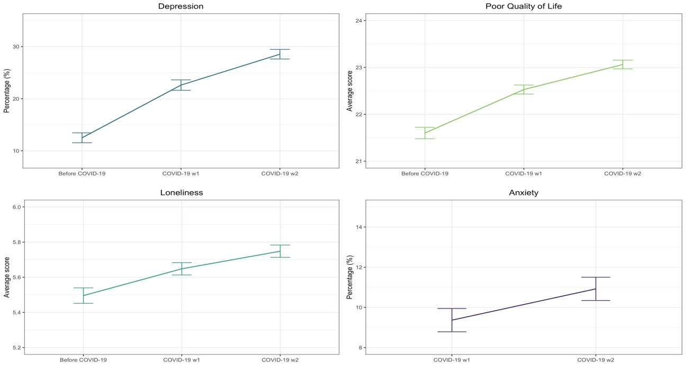
(ii) The longer-term mental health impact of the COVID-19 pandemic
Predicted trajectories of depression and anxiety before and during the COVID-19 pandemic (fixed-effects models).
Depression: 12.5% pre-pandemic; 22.6% COVID-19 w1; 28.5% COVID-19 w2 (p < .001)
Anxiety: 9.4% COVID-19 w1; 11% COVID-19 w2 (p < .001)

Slide 24
(ii) The longer-term mental health impact of the COVID-19 pandemic
Predicted trajectories of quality of life and loneliness before and during the COVID-19 pandemic (fixed-effects models).
Poor Quality of Life: 21.6 pre-pandemic; 22.5 COVID-19 w1; 23.1 COVID-19 w2 (p < .001)
Loneliness: 5.5 pre-pandemic; 5.7 COVID-19 w1; 5.8 COVID-19 w2 (p < .001)

Slide 25
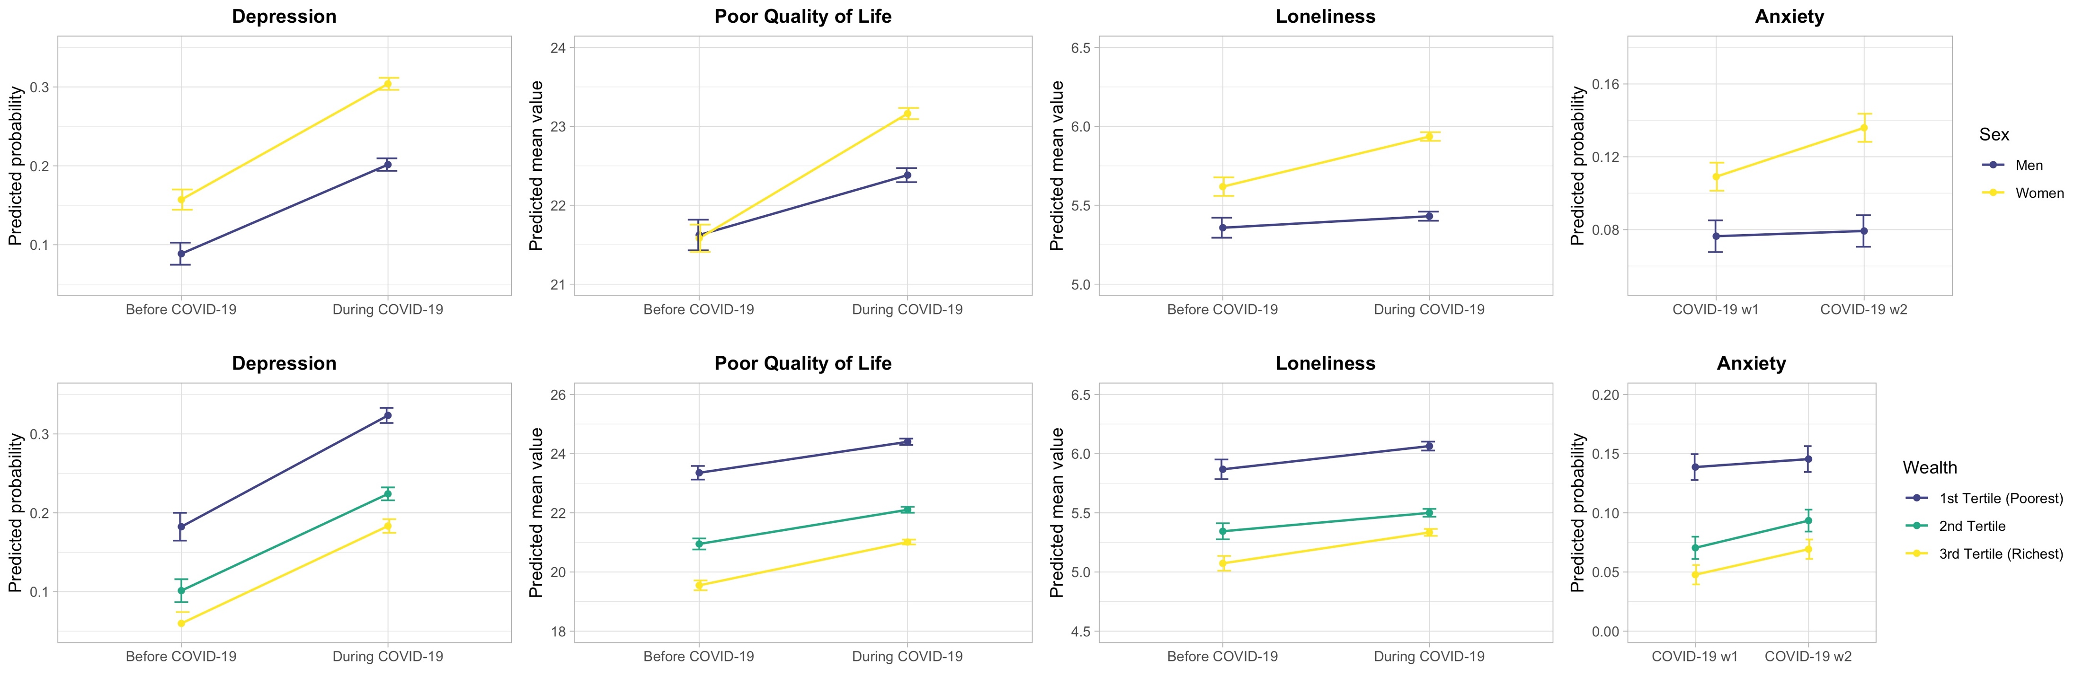
(ii) The longer-term mental health impact of the COVID-19 pandemic
Predicted trajectories of mental health and wellbeing by sex and wealth (fixed-effects models)

Slide 26
(ii) The longer-term mental health impact of the COVID-19 pandemic
Descriptive results from the UK COVID-19 Social Study
Fancourt, Bu, Mak, Paul & Steptoe (2021), Results Release 35
Observed trajectories of depression and anxiety (March 2020 – May 2021)

Slide 27
(ii) The longer-term mental health impact of the COVID-19 pandemic
Descriptive results from the UK COVID-19 Social Study
Fancourt, Bu, Mak, Paul & Steptoe (2021), Results Release 35
Observed trajectories of abuse and self-harm (March 2020 – May 2021)

Slide 28
(iii) Implications and future research priorities
Summary of findings
Initial impact of COVID-19: UK COVID-19 Social Study
High levels of depression, suicidal ideation, and psychological/physical abuse among adults in the UK
Low levels of engagement with formal mental health support services
Higher levels of mental health difficulties in women, people from lower socioeconomic groups, those with experiences of abuse and low social support, and people with pre-existing physical illnesses and mental disorders
Similar patterns observed in other UK studies and in different countries (US, China, Europe)

Slide 29
(iii) Implications and future research priorities
Summary of findings
Longer-term impact of COVID-19: ELSA COVID-19 Substudy and UK COVID-19 Social Study
The mental health and wellbeing of older adults continued to deteriorate throughout 2020, compared with pre-pandemic levels
Women experienced greater deterioration in all mental health outcomes
Socioeconomic inequalities in mental health persisted, but people with higher SEP responded to the pandemic with more negative changes
Levels of depression and anxiety among adults decreased following the introduction of the first national lockdown in March 2020, but then increased as new restrictions were introduced in September 2020
Levels of abuse and self-harm have remained relatively stable over time

Slide 30
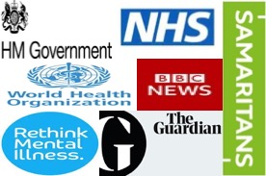
(iii) Implications and future research priorities
Actions to mitigate the mental health impact of COVID-19
Improve availability and accessibility of mental health support services and treatments during COVID-19 (in-person, over the phone, and online)
Implement interventions targeting at-risk individuals (e.g. internet-based informational interventions, address socioeconomic inequalities)
Increase funding for mental health services and charities
Integrate mental health into COVID-19 response and recovery plans
Results from the UK COVID-19 Social Study and
the ELSA COVID-19 Substudy are informing:
Decision makers within government, WHO, Public Health England
Mental health charities
Media and public understanding

Slide 31
(iii) Implications and future research priorities
Research priorities
Long-term monitoring of mental health and wellbeing as the pandemic evolves
Protective factors for mental health during COVID-19
Long-term mental health impact of the pandemic on children
  Incidence of mental health problems among children (5-16 years) rose from 10.8% in 2017 to 16% in July 2020 (Newlove-Delgado et al., 2021)
  Percentage of children eligible for free school meals increased from 17% in 2020 to 21% in January 2021 (BBC News, 2021)
  Childhood adversities, such as child abuse and neglect, violence and conflict between parents, and parental mental health or substance use problems, may have worsen during the current pandemic (Bryant et al., 2020; Sidpra et al., 2021)

Slide 32
Acknowledgments
Prof Daisy Fancourt and Prof Andrew Steptoe
UK COVID-19 Social Study and ELSA’s research teams
Study participants
Funders: Nuffield Foundation, Wellcome Trust, Economic and Social Research Council, National Institute on Aging, and UK Government Departments

Slide 33
References
Ammar, A., Brach, M., Trabelsi, K., Chtourou, H., Boukhris, O., … Hoekelmann, A. (2020). Effects of COVID-19 home confinement on eating behaviour and physical activity: Results of the ECLB-COVID19 international online survey. Nutrients, 12(6). https://doi.org/10.3390/nu12061583
BBC News. (2021). Free school meals: Poorer pupils miss out in funding change, say unions . https://www.bbc.co.uk/news/education-57497297
Beydoun, H. A., Beydoun, M. A., Kaufman, J. S., Lo, B., & Zonderman, A. B. (2012). Intimate partner violence against adult women and its association with major depressive disorder, depressive symptoms and postpartum depression: A systematic review and meta-analysis. Social Science & Medicine, 75(6), 959–975. https://doi.org/10.1016/j.socscimed.2012.04.025
Brooks, S. K., Webster, R. K., Smith, L. E., Woodland, L., Wessely, S., … Rubin, G. J. (2020). The psychological impact of quarantine and how to reduce it: rapid review of the evidence. The Lancet, 395(10227), 912–920. https://doi.org/10.1016/S0140-6736(20)30460-8
Bryant, D. J., Oo, M., & Damian, A. J. (2020). The rise of adverse childhood experiences during the COVID-19 pandemic. Psychological Trauma: Theory, Research, Practice, and Policy, 12(S1), S193–S194. https://doi.org/10.1037/tra0000711
Campion, J., Javed, A., Sartorius, N., & Marmot, M. (2020). Addressing the public mental health challenge of COVID-19. In The Lancet Psychiatry (Vol. 7, Issue 8, pp. 657–659). Elsevier Ltd. https://doi.org/10.1016/S2215-0366(20)30240-6
Correll, C. U., Solmi, M., Veronese, N., Bortolato, B., Rosson, S., … Stubbs, B. (2017). Prevalence, incidence and mortality from cardiovascular disease in patients with pooled and specific severe mental illness: a large-scale meta-analysis of 3,211,768 patients and 113,383,368 controls. World Psychiatry, 16(2), 163–180. https://doi.org/10.1002/wps.20420

Slide 34
References
Daly, M., Sutin, A., & Robinson, E. (2020). Longitudinal changes in mental health and the COVID-19 pandemic: Evidence from the UK Household Longitudinal Study. Psychological Medicine. https://doi.org/10.1017/S0033291720004432
Frankish, H., Boyce, N., & Horton, R. (2018). Mental health for all: a global goal. The Lancet, 392(10157), 1493–1494. https://doi.org/10.1016/S0140-6736(18)32271-2
Gariépy, G., Honkaniemi, H., & Quesnel-Vallée, A. (2016). Social support and protection from depression: systematic review of current findings in Western countries. British Journal of Psychiatry, 209(4), 284–293. https://doi.org/10.1192/bjp.bp.115.169094
Holmes, E. A., O’Connor, R. C., Perry, V. H., Tracey, I., Wessely, S., … Bullmore, E. (2020). Multidisciplinary research priorities for the COVID-19 pandemic: a call for action for mental health science. The Lancet Psychiatry, 0366(20), 1–14. https://doi.org/10.1016/S2215-0366(20)30168-1
House of Commons. (2021). Domestic abuse and Covid-19: A year into the pandemic. https://commonslibrary.parliament.uk/domestic-abuse-and-covid-19-a-year-into-the-pandemic/
Hwang, T.-J., Rabheru, K., Peisah, C., Reichman, W., & Ikeda, M. (2020). Loneliness and social isolation during the COVID-19 pandemic. International Psychogeriatrics, 32(10), 1217–1220. https://doi.org/10.1017/S1041610220000988
Iob, E, Zaninotto, P., Demakakos, P., & Steptoe, A. (2021). The immediate and longer-term impact of the COVID-19 pandemic on the mental health and wellbeing of older adults in England. MedRxiv, 2021.04.30.21256385. https://doi.org/https://doi.org/10.1101/2021.04.30.21256385
Iob, Eleonora, Frank, P., Steptoe, A., & Fancourt, D. (2020). Levels of Severity of Depressive Symptoms Among At-Risk Groups in the UK During the COVID-19 Pandemic. JAMA Network Open, 3(10), e2026064. https://doi.org/10.1001/jamanetworkopen.2020.26064

Slide 35
References
Iob, Eleonora, Steptoe, A., & Fancourt, D. (2020). Abuse, self-harm and suicidal ideation in the UK during the COVID-19 pandemic. The British Journal of Psychiatry, 217(4), 543–546. https://doi.org/10.1192/bjp.2020.130
Lorant, V. (2003). Socioeconomic Inequalities in Depression: A Meta-Analysis. American Journal of Epidemiology, 157(2), 98–112. https://doi.org/10.1093/aje/kwf182
Luo, M., Guo, L., Yu, M., & Wang, H. (2020). The psychological and mental impact of coronavirus disease 2019 (COVID-19) on medical staff and general public – A systematic review and meta-analysis. In Psychiatry Research (Vol. 291). Elsevier Ireland Ltd. https://doi.org/10.1016/j.psychres.2020.113190
Luo, Y., Chua, C. R., Xiong, Z., Ho, R. C., & Ho, C. S. H. (2020). A Systematic Review of the Impact of Viral Respiratory Epidemics on Mental Health: An Implication on the Coronavirus Disease 2019 Pandemic. Frontiers in Psychiatry, 11, 565098. https://doi.org/10.3389/fpsyt.2020.565098
McManus, S., Gunnell, D., Cooper, C., Bebbington, P. E., Howard, L. M., … Appleby, L. (2019). Prevalence of non-suicidal self-harm and service contact in England, 2000–14: repeated cross-sectional surveys of the general population. The Lancet Psychiatry, 6(7), 573–581. https://doi.org/10.1016/S2215-0366(19)30188-9
McManus, T., Bebbington, P., Jenkins, R., & Brugha, T. (2016). Mental health and wellbeing in England: Adult psychiatric morbidity survey 2014. Leeds: NHS Digital.
Meyer, J., McDowell, C., Lansing, J., Brower, C., Smith, L., … Herring, M. (2020). Changes in physical activity and sedentary behavior in response to covid-19 and their associations with mental health in 3052 us adults. International Journal of Environmental Research and Public Health, 17(18), 1–13. https://doi.org/10.3390/ijerph17186469
Newlove-Delgado, T., McManus, S., Sadler, K., Thandi, S., Vizard, T., … Ford, T. (2021). Child mental health in England before and during the COVID-19 lockdown. The Lancet Psychiatry, 8(5), 353–354. https://doi.org/10.1016/S2215-0366(20)30570-8

Slide 36
References
OECD/EU. (2018). Health at a Glance: Europe 2018: State of Health in the EU Cycle. OECD Publishing. https://doi.org/10.1787/fd41e65f-es
ONS. (2020). Domestic abuse in England and Wales overview - Office for National Statistics. https://www.ons.gov.uk/peoplepopulationandcommunity/crimeandjustice/bulletins/domesticabuseinenglandandwalesoverview/november2020
ONS. (2021). Employment in the UK - Office for National Statistics. https://www.ons.gov.uk/employmentandlabourmarket/peopleinwork/employmentandemployeetypes/bulletins/employmentintheuk/february2021
Pierce, M., Hope, H., Ford, T., Hatch, S., Hotopf, M., … Abel, K. M. (2020). Mental health before and during the COVID-19 pandemic: a longitudinal probability sample survey of the UK population. The Lancet Psychiatry, 7(10), 883–892. https://doi.org/10.1016/S2215-0366(20)30308-4
Puccinelli, P. J., da Costa, T. S., Seffrin, A., de Lira, C. A. B., Vancini, R. L., … Andrade, M. S. (2021). Reduced level of physical activity during COVID-19 pandemic is associated with depression and anxiety levels: an internet-based survey. BMC Public Health, 21(1), 1–11. https://doi.org/10.1186/s12889-021-10470-z
Robinson, E., Sutin, A. R., Daly, M., & Jones, A. (2021). A systematic review and meta-analysis of longitudinal cohort studies comparing mental health before versus during the COVID-19 pandemic. MedRxiv, 2021.03.04.21252921. https://doi.org/10.1101/2021.03.04.21252921
Sidpra, J., Abomeli, D., Hameed, B., Baker, J., & Mankad, K. (2021). Rise in the incidence of abusive head trauma during the COVID-19 pandemic. Archives of Disease in Childhood, 106(3), e14–e14. https://doi.org/10.1136/archdischild-2020-319872

Slide 37
References
Steel, Z., Marnane, C., Iranpour, C., Chey, T., Jackson, J. W., … Silove, D. (2014). The global prevalence of common mental disorders: A systematic review and meta-analysis 1980-2013. International Journal of Epidemiology, 43(2), 476–493. https://doi.org/10.1093/ije/dyu038
Usher, K., Bhullar, N., Durkin, J., Gyamfi, N., & Jackson, D. (2020). Family violence and COVID‐19: Increased vulnerability and reduced options for support. International Journal of Mental Health Nursing. https://doi.org/10.1111/inm.12735
WHO. (2019). Global health estimates: Leading causes of DALYs. https://www.who.int/data/gho/data/themes/mortality-and-global-health-estimates/global-health-estimates-leading-causes-of-dalys
World Bank. (2020, January). COVID-19 to Add as Many as 150 Million Extreme Poor by 2021. https://www.worldbank.org/en/news/press-release/2020/10/07/covid-19-to-add-as-many-as-150-million-extreme-poor-by-2021
World Health Organization. (2017). Depression and other common mental disorders: global health estimates. https://doi.org/10.1002/mas

